Slide 1
Purpose
The Feature Engineering Layer transforms the Validated Requirement Model produced by the Requirement Intelligence Layer into governed and executable BDD assets.
The layer is responsible for:
Feature generation
Scenario generation
Scenario outline generation
Test data generation
Feature governance
Gherkin compliance validation
AI-assisted remediation
CP2 validation
Output:
Validated Feature Package

Slide 2
Inputs
Primary Input:
validated-requirement-model.json
Produced by:
Requirement Intelligence Layer
Contains:
{ "feature": "Customer Login", "functionalAcceptanceCriteria": [], "securityAcceptanceCriteria": [], "qualityAcceptanceCriteria": [], "riskBasedScenarios": [] }

Slide 3
Outputs
Work Product 1
Generated Feature Files
Work Product 2
Feature Governance Report
Work Product 3
CP2 Validation Report
Final Work Product
Validated Feature Package

Slide 4
High Level Flow
Validated Requirement Model
Prompt Library
(Existing Copilot Assets)
Feature Generation Engine
Generated Feature Files
Feature Governance Engine
Validated Feature Package
CP2 Validation
AI Remediation Engine
Compliance Metrics Engine
Gherkin Lint

Slide 5
Key Design Principle
Prompt-as-Asset Architecture
Do not hardcode generation logic.
Treat prompts as reusable enterprise assets.
This allows:
Prompt Versioning
Prompt Governance
Prompt Reuse
Prompt Evolution
Prompt Registry
Feature Generation Engine

Slide 6
Components
Component | Purpose
Prompt Registry | Stores approved prompt templates
Feature Generation Engine | Creates feature files
Scenario Generation Engine | Generates scenarios
Scenario Outline Generator | Generates data-driven scenarios
Test Data Generator | Creates example datasets
Feature Writer | Writes feature files
Feature Governance Engine | Validates generated features
Gherkin Lint Adapter | Executes lint validation
Compliance Metrics Engine | Calculates governance metrics
AI Remediation Engine | Fixes violations
CP2 Validation Engine | Determines feature readiness

Slide 7
Prompt Registry
Reuse your existing prompt templates.
Examples:
generate-feature.md
update-feature.md
generate-test-data.md
Registry:
{ "featureGenerationPrompt": "generate-feature.md", "scenarioOutlinePrompt": "generate-scenario-outline.md", "testDataPrompt": "generate-test-data.md", "validationPrompt": "validate-feature.md" }

Slide 8
Feature Generation Engine
Sample Input
{ "feature": "Customer Login", "functionalAcceptanceCriteria": [], "securityAcceptanceCriteria": [], "qualityAcceptanceCriteria": [] }
Process
Select prompt from registry
Inject requirement model
Call Azure OpenAI
Generate feature content
Sample Output
@authentication Feature: Customer Login Scenario: Successful Login Given user is on login page When user enters valid credentials Then user should be logged in

Slide 9
Scenario Generation Rules
Generate:
Positive Scenarios
Happy Path
Negative Scenarios
Invalid Credentials Locked User Missing Data
Security Scenarios
Derived from OWASP ZAP
Examples:
Brute Force Attempts Session Timeout Unauthorized Access
Quality Scenarios
Derived from Sonar Findings
Examples:
Input Validation

Slide 10
Scenario Outline Generator
Input:
Acceptance Criteria
Output:
Scenario Outline: Examples: | username | password |

Slide 11
Test Data Generator
Input:
Requirement Model
Output:
{ "positiveData": [], "negativeData": [], "boundaryData": [] }

Slide 12
Feature Governance Engine
Reuses existing POC components.
Validation | Tool
Feature Naming | Gherkin Lint
Scenario Naming | Gherkin Lint
Duplicate Scenarios | Gherkin Lint
Empty Scenarios | Gherkin Lint
Missing Tags | Gherkin Lint
Scenario Length | Gherkin Lint
Formatting | Gherkin Lint

Slide 13
Compliance Metrics Engine
Reuse metrics already implemented.
Lint Violations Count
% Compliant Feature Files
Feature Naming Violations
Scenario Naming Violations
Missing Steps / Empty Scenarios
Tagging Compliance %
Tagging Violations
Duplicate Scenarios
Formatting Violations
Structure Violations
Total Scenarios
Avg Scenario Length
Max Scenario Length
Scenario Size Violations
These become part of the Feature Governance Report

Slide 14
AI Remediation Engine
Purpose:
Automatically fix violations.
Input:
{ "rule":"no-dupe-scenario-names", "message":"Duplicate scenario detected" }
Process:
Output:
Remediated Feature
Violation ↓ Remediation Prompt ↓ Azure OpenAI ↓ Updated Feature File

Slide 15
CP2 Validation Rules
Rule | Pass Criteria
Feature Generated | Yes
Lint Violations | 0 Critical
Naming Compliance | >95%
Tagging Compliance | >95%
Duplicate Scenarios | 0
Empty Scenarios | 0
Scenario Size Violations | Within threshold
Acceptance Criteria Coverage | 100%

Slide 16
CP2 Validation Report
{ "controlPoint":"CP2", "status":"PASSED", "summary":{ "featuresGenerated":5, "totalScenarios":25, "lintViolations":0, "taggingCompliance":"100%", "acceptanceCriteriaCoverage":"100%" }, "humanReviewRequired":false }

Slide 17
Human-in-the-Loop Conditions
Requires review when
Feature generation confidence low
Acceptance criteria not mapped
Lint violations persist after remediation
Security scenarios missing
Generated feature changes business intent
CP2 validation fails

Slide 18
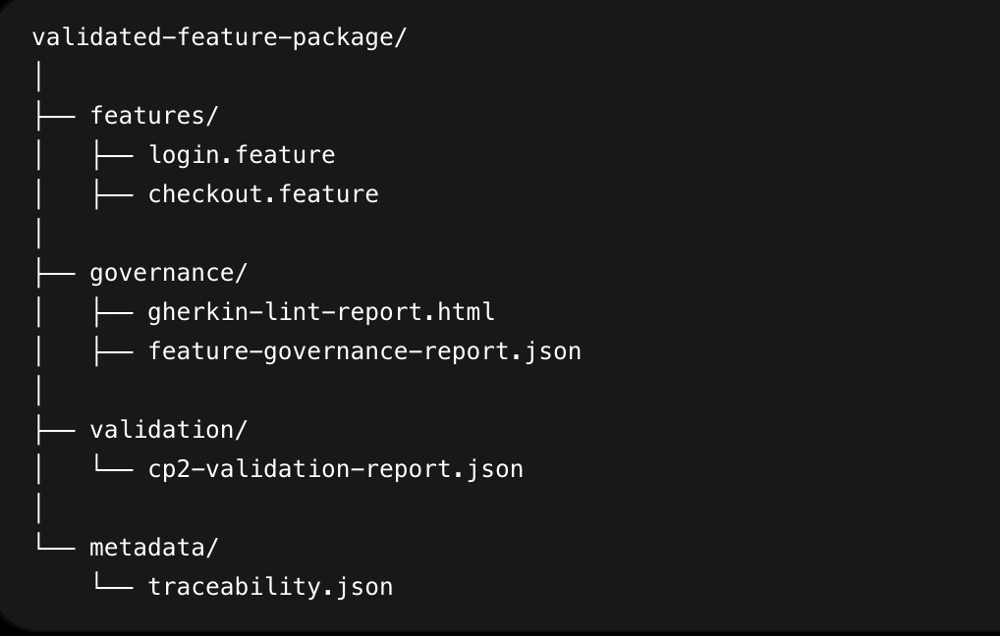
Output Package

Slide 19
Integration with Next Layer
Output:
Validated Feature Package
Consumed by:
Automation Engineering Layer
The Automation Engineering Layer will use these feature files together with the existing Copilot prompt library to generate:
Step Definitions
Page Objects
Automation Code
which is why preserving traceability from requirements → features is critical in this layer.

Slide 20
Implementation Task Breakdown
Task | Sub-task | Output
Create Prompt Registry | Register approved prompt templates (generate-feature, update-feature, generate-test-data, generate-scenario-outline, validate-feature) | prompt-registry.json
Build Prompt Loader | Load prompts dynamically from registry | Prompt loading framework
Create Feature Generation Service | Read validated requirement model and invoke feature generation prompt | Generated feature content
Create Scenario Generation Service | Generate positive, negative, security, and quality scenarios | Scenario set
Create Scenario Outline Generator | Generate data-driven scenarios and examples tables | Scenario outlines
Create Test Data Generator | Generate positive, negative, boundary test data | Test data package
Create Feature Writer | Persist generated features to feature files | *.feature files
Create Traceability Generator | Map requirements → acceptance criteria → scenarios | traceability.json
Build Governance Engine | Orchestrate feature validation workflow | Governance workflow
Integrate Gherkin Lint | Execute lint checks against generated features | gherkin-lint-report.json
Integrate Existing HTML Report Generator | Reuse current gherkin HTML report solution | gherkin-lint-report.html
Integrate Existing Metrics Engine | Reuse current governance metrics calculations | Feature governance metrics
Build Compliance Metrics Aggregator | Consolidate lint and governance metrics | feature-governance-report.json
Build AI Remediation Service | Invoke remediation prompt for lint violations | Remediated feature files
Create Remediation Workflow | Re-run validation after remediation | Remediation cycle
Build CP2 Validation Engine | Execute CP2 rules and readiness checks | cp2-validation-report.json
Create Feature Package Builder | Bundle features, reports, validation results, and traceability | Validated Feature Package
Create Output Writer | Persist all work products | Output package
Create Unit Tests | Test prompt loader, generators, validators, remediation flow | Test results
Create Sample Requirement Models | Build representative inputs from CP1 outputs | Demo data
End-to-End Dry Run | Execute full CP1 → CP2 workflow | Validated Feature Package

Slide 21
Definition of Done
The Feature Engineering Layer is complete when:
Prompt Registry is operational.
Validated Requirement Model can generate feature files.
Positive, negative, security, and quality scenarios are generated.
Scenario outlines and test data are generated.
Requirement-to-scenario traceability is maintained.
Generated features pass Gherkin governance checks.
Compliance metrics are generated.
AI remediation successfully fixes common violations.
CP2 validation report is generated.
Validated Feature Package is produced.
Output can be consumed directly by the Automation Engineering Layer.

Slide 22
Estimated Effort Summary
Activity | Effort
Prompt Registry & Prompt Loader | 2 Days
Feature Generation Services | 3 Days
Scenario & Test Data Generation | 2 Days
Feature Writer & Traceability | 2 Days
Governance Integration (Reuse Existing Assets) | 2 Days
AI Remediation | 3 Days
CP2 Validation Engine | 2 Days
Output Packaging | 1 Day
Unit Testing | 2 Days
End-to-End Dry Run | 1 Day

